Slide 1
Force Due to
Liquid Pressure

Slide 2
Force Due to Liquid Pressure
The force F on an area A at a depth h in a liquid of density w is given by
F = w h A
The force will increase if the density increases, or if the depth increases or if the area increases.
So if we have an unevenly shaped plate submerged vertically in a liquid, the force on it will increase with depth. Also, if the shape of the plate changes as we go deeper, we have to allow for this.

Slide 3
The force due to liquid pressure at the bottom of any two containers are equal since the bottom has the same areas and the depths of the liquid are equal.
For a horizontal plate submerged in a liquid, the force due to liquid pressure is uniform throughout the plate
For a vertical plate submerged in a liquid, the force is greater on the lower part due to the height.

Slide 4
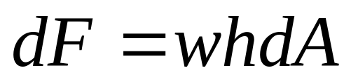
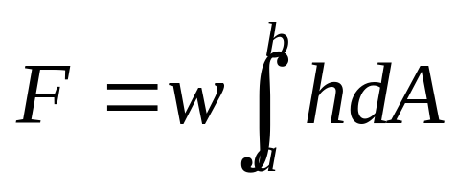
In differential form,
In integral form,
Where h is the distance of the element or the strip from the liquid surface.

Slide 5
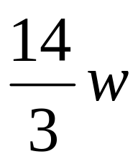
Example 1
A trough having a trapezoidal cross section is full of water. If the trapezoid is 3m wide at the top, 2m wide at the bottom and 2m deep, find the total force owing to liquid pressure on one end of the trough.
answer
N

Slide 6
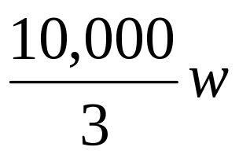
Example 2
The face of a dam adjacent to the water is vertical and its shape is in the form of an isosceles triangle 250 m wide across the top and 100m in the center. If the water is 20m deep in the center, find the total force on the dam due to liquid pressure.
answer

Slide 7
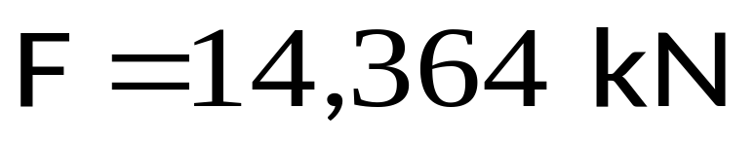
Example 3
Find the force on one side of a cubical container 6.0 cm on an edge if the container is filled with mercury. The weight density of mercury is 133 kN/cubic meters.

Slide 8
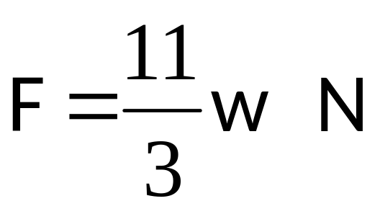
Example 4
A right triangular plate of base 2.0 m and height 1.0 m is submerged vertically, with the top vertex 3.0 m below the surface. Find the force on one side of the plate.

Slide 9
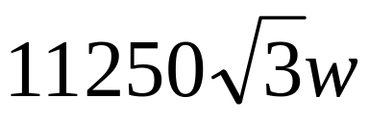
Example 5
The face of a dam adjacent to the water is inclined at an angle of 30 degrees from the vertical. The shape of the face is a rectangle of width 50m and slant height of 30m. If the dam is full of water, find the total force due to liquid pressure on the face.
N
answer

